Slide 1


Frequency Divider (Clock Divider)
ECE-111 Advanced Digital Design Project

Slide 2
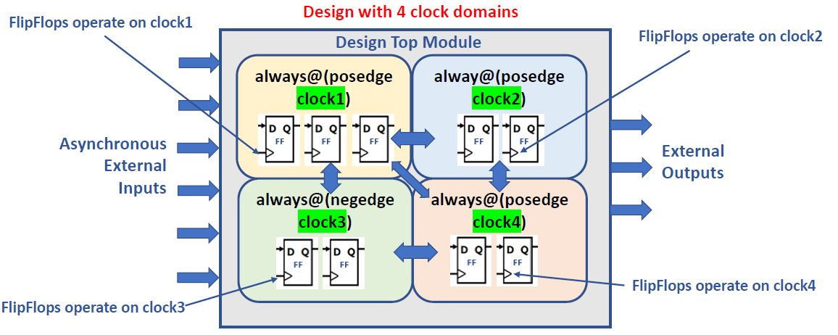
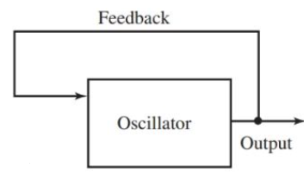
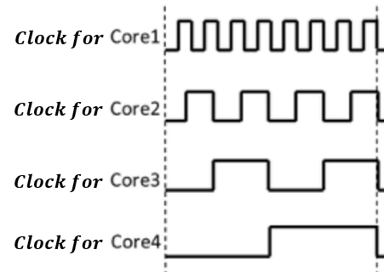



Clock
Clock is a signal which is repetitive in nature after some period of time
In digital circuits, clock is a smallest unit of time when processing happens and sometimes it is also called as a “cycle”
Modern digital systems have multiple clocks where each of the core clock vibrates at a specific frequency
Clock frequency is typically measured in MHz or GHz
Typically, in digital systems multiple clocks with desired frequency are generated using frequency divider from a single reference clock
Clock Divider
$$fin⋰n$$
Core1
Core2
Clock Divider
$$fin⋰n$$
Core3
Core4

Slide 3
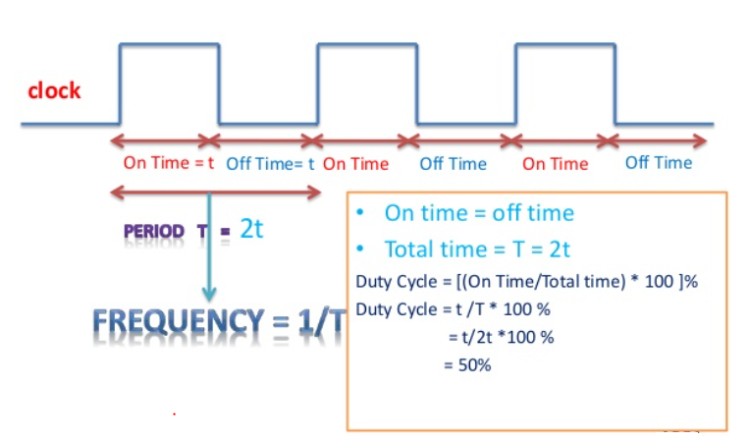
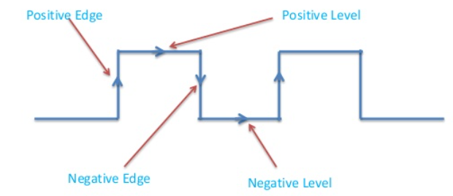
Clock Parameter Definitions
Positive edge = 0 to 1 transition (also know as Posedge or Rising Edge)
Negative edge = 1 to 0 transition (also know as Negedge or Falling edge)
Positive Level = Positive edge to Negative edge (also know as ACTIVE HIGH Level)
Negative Level = Negative edge to Positive edge (also know as ACTIVE LOW Level)
1 Clock Time Period (T) = Time between successive transitions in the same direction
Positive edge to Positive edge OR Negative edge to Negative edge
Clock Width (t) = Time during which the value of the clock signal is HIGH or LOW
Frequency = 1 / Clock Time Period = 1 / T
Duty Cycle = Ratio of clock on time to clock off time (or Ratio of clock width ‘t’ to clock period ‘T’)
t=clock width
clock
→ 50% duty cycle
T = 1 Clock Time Period

Slide 4
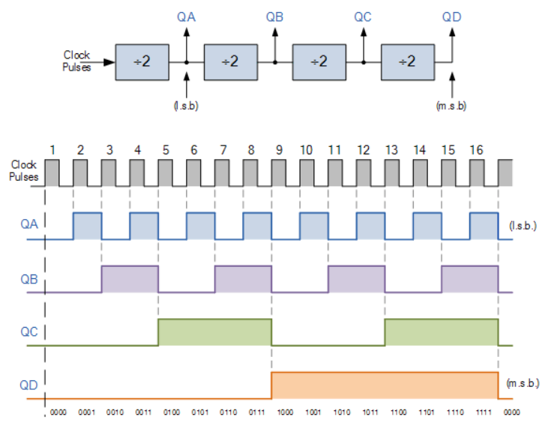
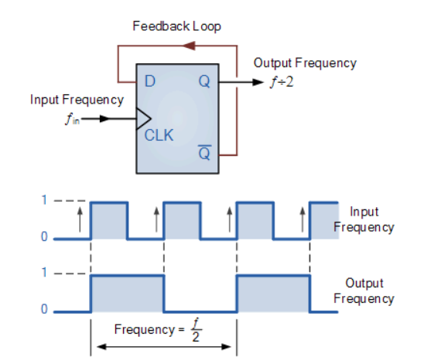



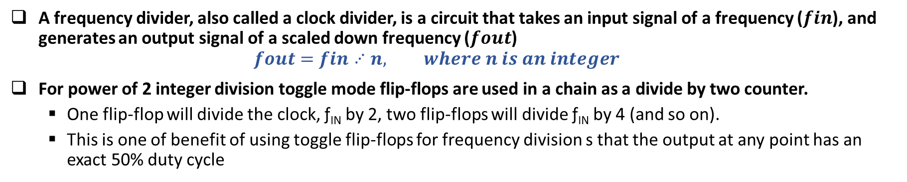





What is a Frequency Divider ?
A frequency divider, also called a clock divider, is a circuit that takes an input signal of a frequency ($fin$), and generates an output signal of a scaled down frequency ($fout$)
$$fout=fin⋰n, where n is an integer$$
For power of 2 integer division toggle mode flip-flops are used in a chain as a divide by two counter.
One flip-flop will divide the clock, ƒ_{IN} by 2, two flip-flops will divide ƒ_{IN} by 4 (and so on).
This is one of benefit of using toggle flip-flops for frequency division s that the output at any point has an exact 50% duty cycle
$fin$ / 2
$fin$ / 4
$fin$ / 8
$fin$ / 16
$fin$ / 2
$fin$ /4
$fin$ / 8
$fin$ / 16

Slide 5
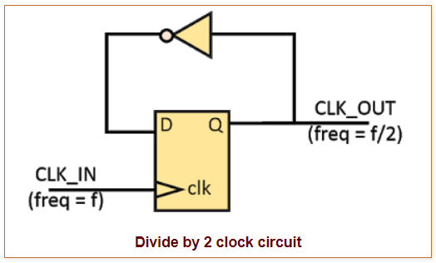
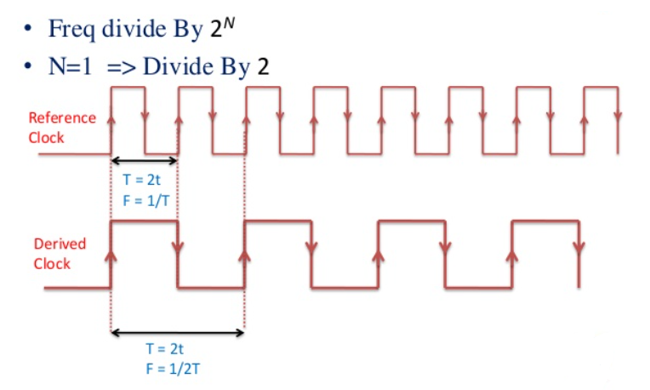
CLock Divide by 2
Clock divide by 2 can be developed using single D-FlipFlop with inverted output of flipfop connected to input ‘D’ of flipflop
Reference clock (CLK_IN) is connected to flipflop clock pin
Flipflop output Q produces derived clock (CLK_OUT) which is 1/2 time of CLK_IN time period
module clock_divide_by_2(
input CLK_IN, reset,
output logic CLK_OUT);
always_ff@(posedge CLK_IN, posedge reset)
if (reset)
CLK_OUT <= 0;
else
CLK_OUT <= ~CLK_OUT;
endmodule: clock_divide_by_4
CLK_IN
CLK_OUT

Slide 6
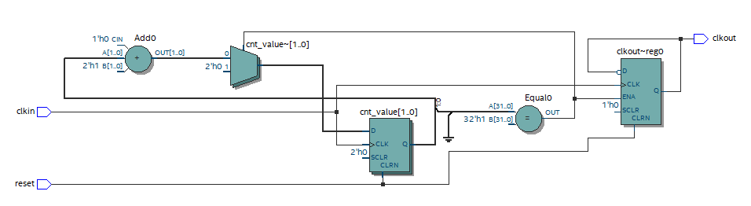
Clock Divide by 4
module clock_divide_by_4 #(parameter N = 4)(
input clkin, reset,
output logic clkout);
logic [$clog2(N)-1:0] cnt_value;
always_ff@(posedge clkin, posedge reset)
begin
if (reset) begin
cnt_value <= 0;
clkout <= 0;
end
else if(cnt_value == $clog2(N)-1) begin
cnt_value <= 0;
clkout <= ~clkout;
end
else
cnt_value <= cnt_value + 1;
end
endmodule: clock_divide_by_4
$clog2 function returns the ceiling of the logarithm to the base 2.
Example :
for N=4, $clog2(4) will return 2
for N=6, $clog2(6) will return 3
For N=8, $clog2(8) will return 3
cnt_value <= cnt_value +1;
clkout<= ~clkout;
For N=2, after cnt_value of 0, 1 clk_out value will be flipped from previous value
cnt_value == $clog2(N)-1
Question : If parameter N value is changed in SystemVerilog code to value 8, would above mentioned circuit work as divide by 8 ?

Slide 7
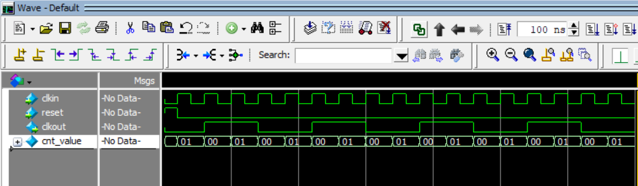
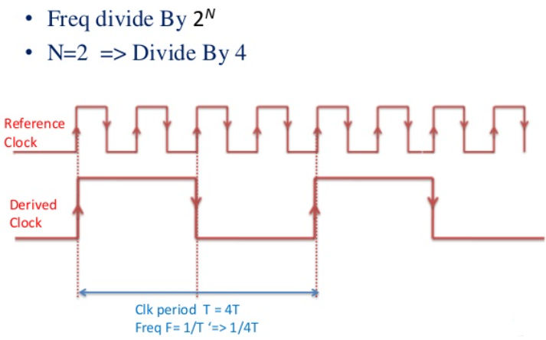
Clock Divide by 4 Example
1
2
3
4
clkout is 4 times slower than clkin
clkin
clkout

Slide 8
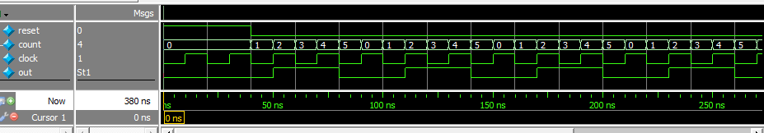
Let’s Design Clock Divide by 3
Note: Over a count of 6, we have three full clock cycles and one full out cycle.

Slide 9
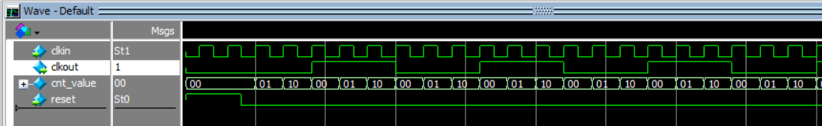
Clock Frequency Divide by 3
Can clock divide by 4 implementation code re-used to create clock divide by 3 logic ?
module clock_divide_by_3(
input logic clkin, reset,
output logic clkout);
logic [1:0] cnt_value;
always_ff@(posedge clkin or posedge reset)
begin
if (reset == 1) begin
cnt_value <= 0;
clkout <= 0;
end
else if(cnt_value == 2) begin
cnt_value <= 0;
clkout <= ~clkout;
end
else
cnt_value <= cnt_value + 1;
end
endmodule: clock_divide_by_3
Would changing cnt_value == 2 (i.e. counting 0,1,2) result in clock divide by 3 ?
Answer : No !
It will behave as clock divide by 6 instead of 3 since cnt_value is incremented at every posedge of clkin, so clkout will be ‘1’ for 3 clkin cycles and ‘0’ for 3 clkin cycles.
So 1 clkout == 6 clkin. See below
clkout time period is 6 times than clkin time period
1
2
3
4
5
6

Slide 10
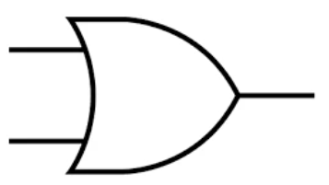
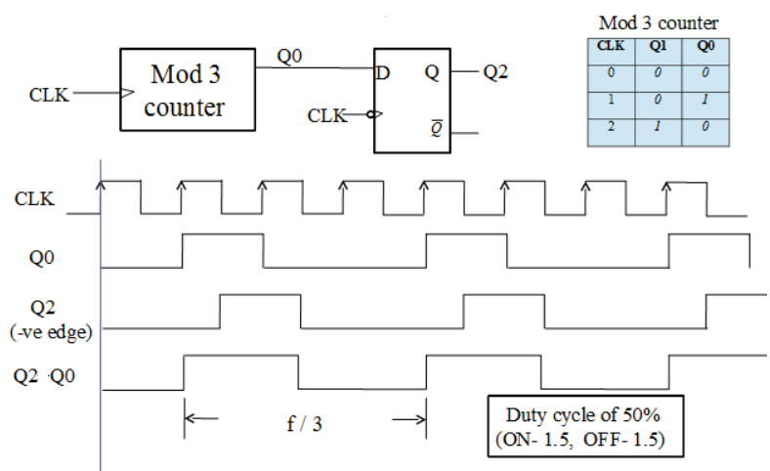
Clock Divide by 3 (F/3) – Implementation 1
Clock Frequency divide by 3 using Modulo-3 counter
(Q2 | Q0 )= CLKOUT
POSEDGE
NEGEDGE
1
2
3
CLKOUT =

Slide 11
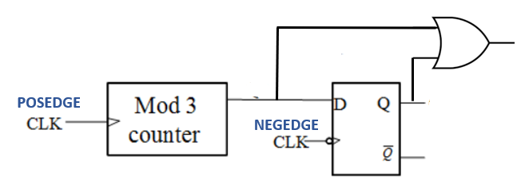
Clock Divide by 3 (Implementation-1)
module clock_divide_by_3(
input clkin, reset,
output logic clkout);
logic [1:0] cnt_value;
logic count3_done, r_count3_done;
always_ff@(posedge clkin, posedge reset) begin
if (reset) begin
cnt_value <= 0;
end
else begin
if(cnt_value == 2) begin
…..
…..
end
else begin
…..
…..
end
end
end
…continued
clkout
count3_done
r_count3_done
Implement negedge clk triggered flipflop to register output of modulo-3 counter “count3_done”
Implement Modulo-3 counter which does binary count of 0,1,2 and once count value reaches 2, then set count3_done to = 1 and count value is reset to ‘0’
always_ff@(<add sensitivity list, remember negegde clk>) begin
if (reset) begin
…..
end
else begin
…..
end
end
assign clkout = (count3_done | r_count3_done);
endmodule: clock_divide_by_3

Slide 12
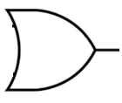
Clock Divide by 3 (Implementation-2)
Alternate implementation using two counters ?
One counter for counting posedge of clkin and other counting negedge of clkin
Whenever either counter reaches a count of ‘2’ (i.e. counts 0,1,2 three edges then generate clkout=1
module clock_divide_by_3 (
input clkin, reset,
output logic clkout);
// local counter variable
logic [1:0] posedge_count, negedge_count;
// posedge clock counter
always_ff@(posedge clkin) begin
…..
…..
end
// negedge clock counter
always_ff@(negedge clkin) begin
…..
…..
end
// generate divide by 3 clock
assign clkout = ((posedge_count == 2) | (negedge_count == 2));
endmodule: clock_divide_by_3
Positive Edge Clock Counter
clkin
clkout
Negative Edge Clock Counter
Add Reset condition
In Non-reset condition increment posedge_count ?
clkin
Add Reset condition
In Non-reset condition increment negedge_count ?

Slide 13
Homework Assignment
Develop SystemVerilog RTL model for Clock Divide By 2N+1 (odd factor)
Synthesize clock divide by 7 design and run simulation using testbench provided
Review synthesis results (resource usage and RTL netlist/schematic)
Review input and output signals in simulation waveform.
Assume below mentioned primary port names and SystemVerilog RTL module name clock_divide_by_3.
Primary Ports for carry_lookahead_adder module
Input clkin, reset (Asynchronous active high reset)
Output clkout
Report should include :
SystemVerilog design
Synthesis resource usage and schematic generated from RTL netlist viewer
Simulation snapshot and explain simulation result to confirm RTL model developed works as clock divide by 7
clkin
clock_divide_by_3
clkout
reset

